Slide 1
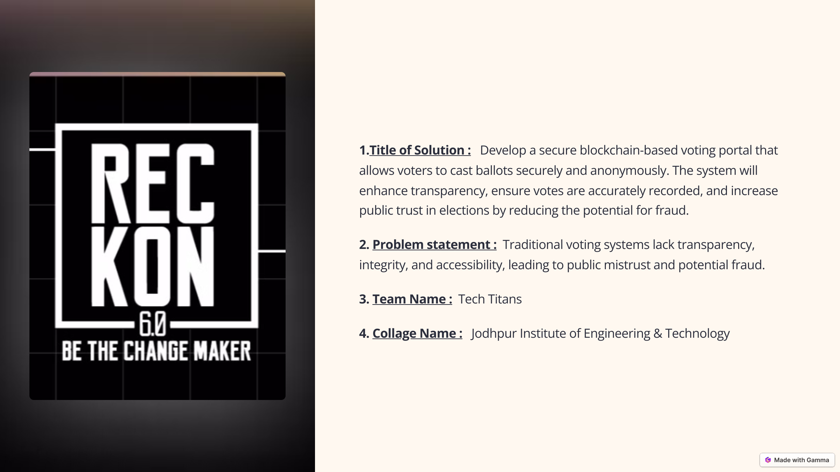

Title of Solution : A blockchain-powered secure and transparent voting system ensuring integrity, anonymity, and trust in elections.
2. Problem statement : Traditional voting systems lack transparency, integrity, and security, leading to public mistrust, potential fraud, and limited accessibility. A decentralized and tamper-proof solution is needed to ensure fair, anonymous, and verifiable elections.
3. Team Name : Tech Titans
4. Collage Name : Jodhpur Institute of Engineering & Technology

Slide 2

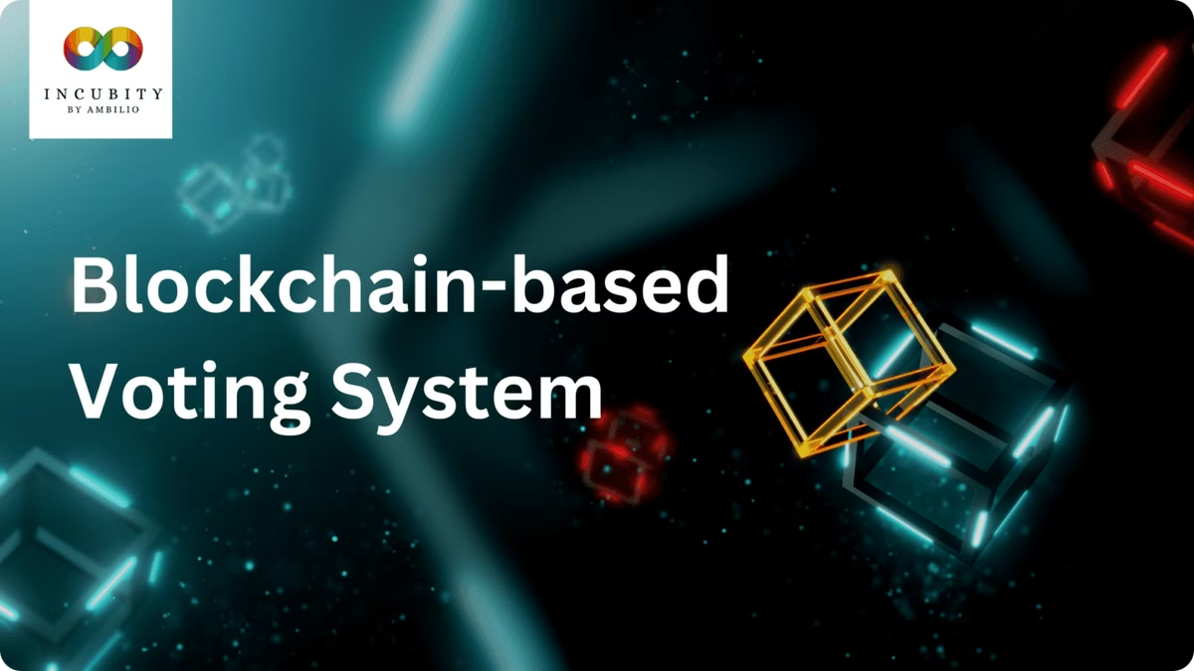
Blockchain-Based Voting Portal: A Secure and Transparent Solution
This presentation explores the development and implementation of a secure and transparent voting portal using blockchain technology.

Slide 3

Content Table :
Introduction 01
Proposed Solution 02
Key Technology Used 03
Workflow / architecture 04
Detailed Features 05
Innovation In Solution 06
Challenge and Solution 07
Future Scope 08
Conclusion 09
Thank You. 10

Slide 4
Introduction
1. Traditional voting methods are vulnerable to fraud, manipulation, and lack of transparency.
2. The Candidate Must Available On Voting Boot .
3. More Expensive
1. Blockchain technology offers a secure, transparent, and immutable platform for conducting elections.
2. Any Eligible Candidate can Vote From Anywhere
3. Less Expensive

Slide 5
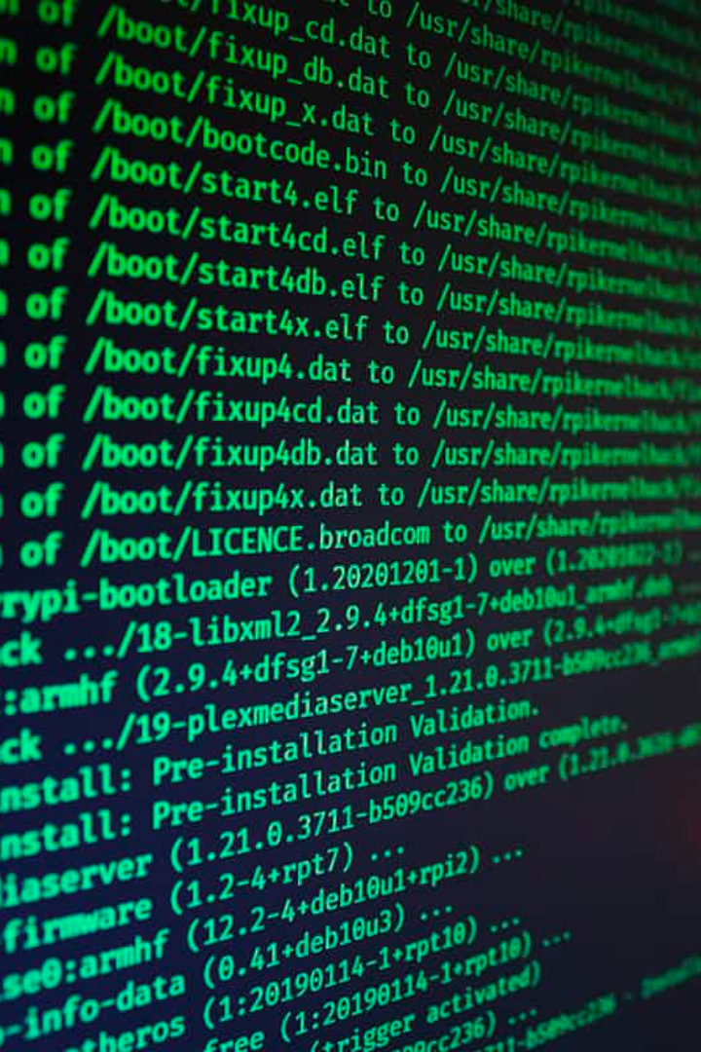
Proposed Solution
Blockchain-based platform
Secure voter authentication
Ensures secure, tamper-proof storage of votes.
Uses biometrics or digital signatures to verify voter identity.
Encrypted voting process
Real-time vote tallying
Provides transparent and verifiable results.
Protects the privacy and confidentiality of voter choices.

Slide 6

Key Technologies Used
Smart Contracts
Cryptography
Automate voting processes, ensuring secure and transparent vote counting.
Encrypts voter identities and vote data, protecting privacy.
Distributed Ledger Technology
User Interface
Provides a user-friendly interface for voters to cast ballots securely.
Creates a secure and transparent record of all votes.

Slide 7
Architecture/Workflow
Voter registration and authentication using biometric verification or digital signatures.
1
2
Casting votes through a secure and encrypted interface.
Votes recorded on the blockchain, ensuring immutability and transparency.
3
4
Real-time vote counting and results verification.
Official declaration of election results with complete audit trail.
5

Slide 8






Detailed Features
Voter Verification
Data Security
Rigorous verification process to prevent voter fraud.
Encryption and secure storage of voter data and votes.
Audit Trail
Accessible Interface
A complete record of all voting activities for transparency.
User-friendly interface for easy and intuitive voting.

Slide 9
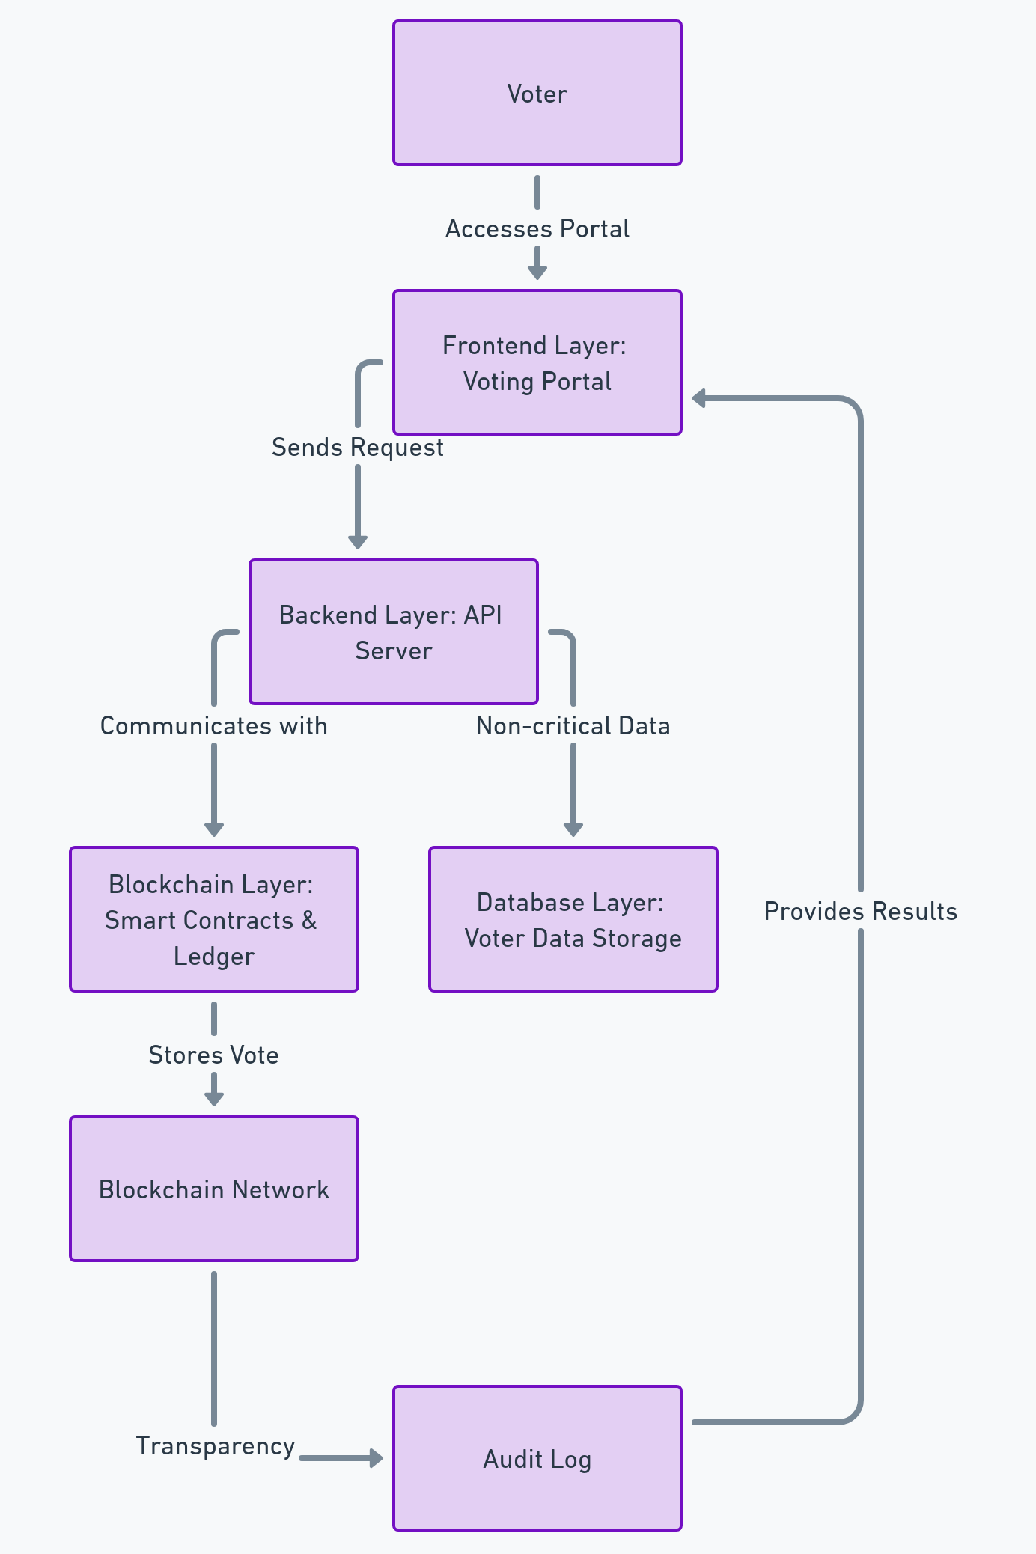
Blockchain-Based Secure Voting System Architecture
_____________________________
1. Smart Contracts → Solidity
2. Voting Portal → ReactJS
3. API Server → Node.js
4. Data Storage → MongoDB
5. Blockchain → Ethereum
6. Audit Log → Transparency Tool

Slide 10






Innovation in the Solution
Integration with existing voter databases for seamless registration.
Mobile-first design to enhance accessibility and user engagement.
Decentralized architecture for enhanced security and resilience.
Gamification features to increase voter participation.

Slide 11




Challenges and Solutions
Security Threats
1
Implement robust security measures.
Scalability
2
Design a scalable platform for large-scale elections.
Accessibility
3
Ensure user-friendly interface for all demographics.
Public Awareness
4
Promote awareness and build trust in the system.

Slide 12
Future Scope
Integration with other government services
1
Improve efficiency and transparency.
Real-time vote counting and results display
2
Increase trust and transparency in elections.
Development of a mobile app
3
Enhance accessibility and user engagement.
Exploration of new blockchain technologies
4
Explore new innovations for enhanced security and scalability.

Slide 13

Conclusion
The blockchain-based voting portal offers a secure, transparent, and efficient solution for modern elections. By leveraging the power of blockchain technology, this platform can address the challenges of traditional voting systems and build trust in the electoral process.
VoteChain ensures secure, transparent, and tamper-proof elections using blockchain & smart contracts. 🛡️ Every vote is immutable & verifiable, eliminating fraud 🚀. With a user-friendly UI, robust backend & decentralized security, it’s the future of digital voting! 🗳️✨

Slide 14


